Slide 1
FIREWALL
NAME : BHUPESH BORKAR

Slide 2
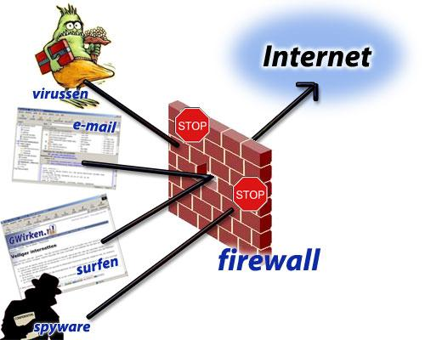
Introduction
The word firewall means a network device that is used to block certain types of network traffic. Basically, firewall forms a barrier between a trusted and an untrusted network.
1.Firewalls control the flow of network traffic
2.Firewalls have applicability in networks where there is no internet connectivity
3.Firewalls operate on number of layers
4.Can also act as VPN gateways
5. Active content filtering technologies

Slide 3
Types Of Firewall
Packet filtering firewall
Stateful firewall
Deep packet inspection firewall
Application-aware firewall
Application proxy firewall

Slide 4
Firewall Environments
1.There are different types of environments where a firewall can be implemented.
2.Simple environment can be a packet filter firewall
3.Complex environments can be several firewalls and proxies

Slide 5
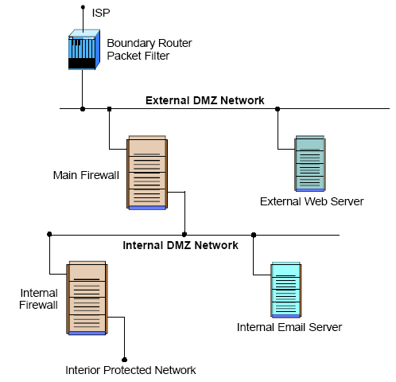
DMZ Environment
1.Can be created out of a network connecting two firewalls
2.Boundary router filter packets protecting server
3.First firewall provide access control and protection from server if they are hacked

Slide 6
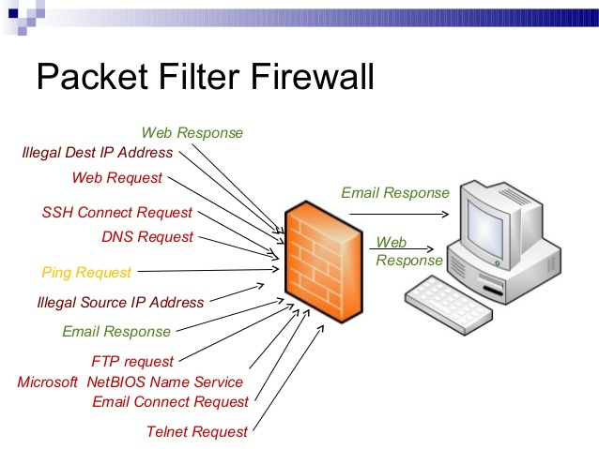
Packet Filtering Firewall
In this type of firewall, there are security rules that block traffic based on IP address and IP protocol.
Filtering Rules are based on information contained in a network.
Source IP address
Destination IP address
Source and destination transport level address
IP protocol field
Interface

Slide 7
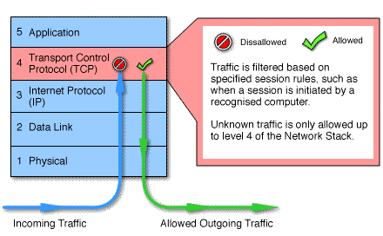
Circuit level
Circuit level gateways work at the session layer of the OSI model, or the TCP layer of TCP/IP
Monitor TCP handshaking between packets to determine whether a requested session is legitimate.

Slide 8
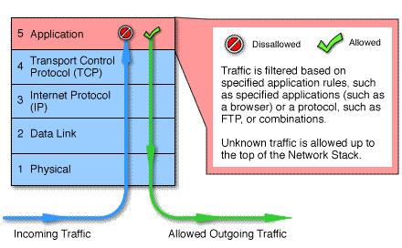
Application Level
1. Application level gateways, also called proxies, are similar to circuit-level gateways except that they are application specific
2.Gateway that is configured to be a web proxy will not allow any ftp, gopher, telnet or other traffic through

Slide 9
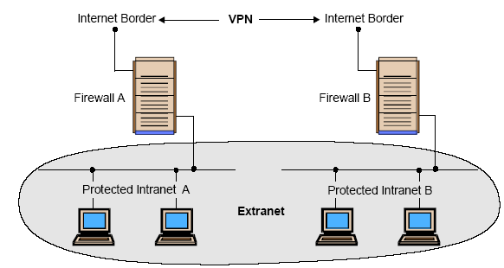
Intranets
1. An intranet is a network that employs the same types of services, applications, and protocols present in an Internet implementation, without involving external connectivity
2. Intranets are typically implemented behind firewall environments.

Slide 10
FIREWALLS APPLICATIONS
1. Firewalls will continue to advance as the attacks on IT infrastructure become more and more sophisticated
2. More and more client and server applications are coming with native support for proxied environments
3. Firewalls that scan for viruses as they enter the network and several firms are currently exploring this idea, but it is not yet in wide use

Slide 11
Conclusion
1. It is clear that some form of security for private networks connected to the Internet is essential
2. A firewall is an important and necessary part of that security, but cannot be expected to perform all the required security functions.

